Slide 1
Git and GitHub for Beginners
Kailash Chand Meena

Slide 2
Overview
What is git?
How does git work?
Basic Git commands
What is GitHub?
Install Git and create GitHub account
Additional Resources

Slide 3

1
What is git?

Slide 4

Why git is useful?

Slide 5
Use cases
Consider this scenario:
You have a homework submission in college for today and the assignment is ready for submission
While testing it you discovered a minor bug and decided to fix it

Slide 6
Use cases
After attempting to do so, you accidentally changed a working code and got yourself in a big mess
You no longer remember what was and what wasn’t there
It is 23:58 PM

Slide 7
Now you realize that CTRL + Z won’t solve your
problems

Slide 8
What is version control system?
Version control system is a system that records changes to a file or
set of files over time so that you can recall specific versions later
Allows for collaborative development
Allows you to know who made what changes and when
Allows you to revert anychanges and goback to a previous state

Slide 9



What is git?
Git isn’t the only version control system
But (we think) it’s the best
Started in 2005
Created by Linus Torvald to aid in Linux kernel development

Slide 10

Osum right!!!

Slide 11
What is Distributed version control?
Distributed means that there is no main server and all of the full
history of the project is available once you cloned the project.
Users keep entire code and history on their location machines
Users can make any changes without internet access
(Except pushing and pulling changes from a remote server)

Slide 12

2
How does git work?

Slide 13
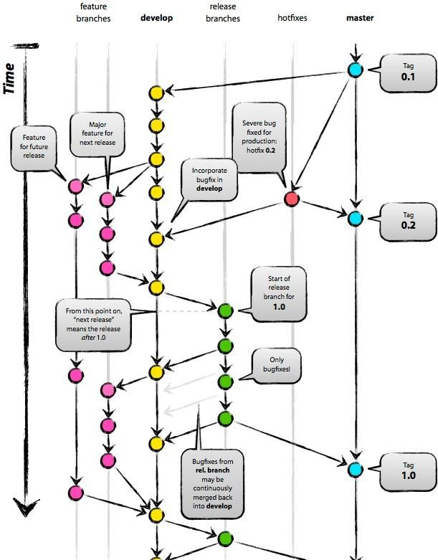
“A successful Git branching model”

Slide 14
How does git work?
Can be complicated at first, but there are a few key concepts
Important git terminology in following slides are blue

Slide 15
Key Concepts: Snapshots
The way git keeps track of your code history
Essentially records what all your files look like at a given point in time
You decide when to take a snapshot, and of what files
Have the ability to go back to visit any snapshot
Your snapshots from later on will stay around, too

Slide 16
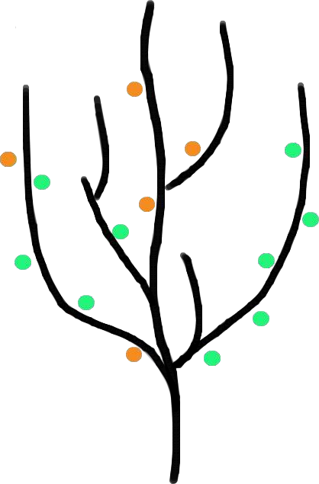
Key Concepts: Commit
The act of creating a snapshot
Can be a noun or verb
“I commited code”
“I just made a new commit”
Essentially, a project is made up of a bunch of
commits
Commit makes a tree structure where each
commit creates a new node in that tree.

Slide 17
Key Concepts: Commit
A commit object mainly contains three things:
A set of changes the commit introduces
Commit message describing the changes
A hash, a 40-character string that uniquely identifies the commit

Slide 18
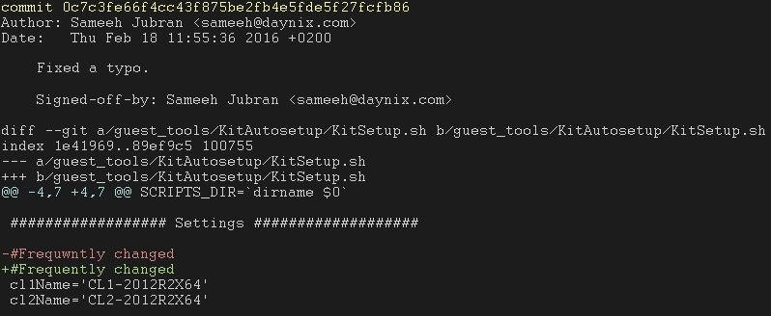
Commit
Commit id (hash)
Commit message
The change the commit introduces

Slide 19
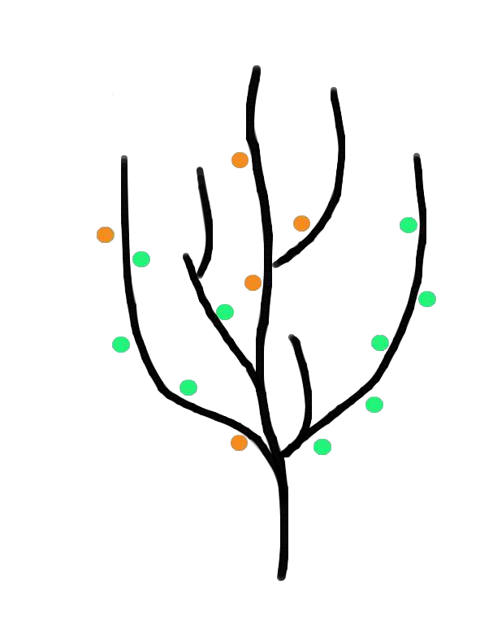
Key Concepts: Repositories
Often shortened to ‘repo’
The purpose of git is to manage a project, or
a set of files, as they change over time. Git stores this information in a data structure called a repository
A repository (‘repo’) is agraph of commits.

Slide 20
Key Concepts: Repositories
Can live on a local machine or on a remote server (GitHub!)
The act of copying a repository from a remote server is called cloning
Cloning from a remote server allows teams to work together

Slide 21
Key Concepts: Repositories
The process of downloading commits that don’t exist on your machine
from a remote repository is called pulling changes
The process of adding your local changes to the remote repository is called pushing changes

Slide 22
Key Concepts: Branches
All commits in git live on some branch
But there can be many, many branches
The main branch in project is called the master branch

Slide 23
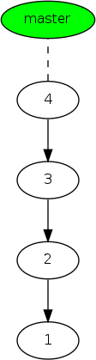
Branch
Consider the graph as linked list
Traditionally, the top of a linked list has a name.
That name is a BRANCH name.
23 / 52

Slide 24
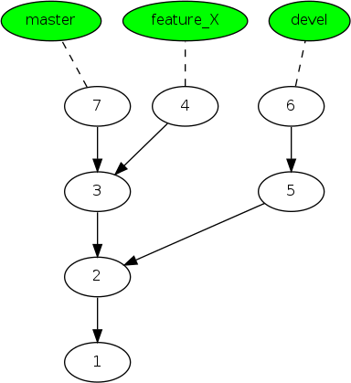
More than one branch
Remember wesaid a repo is a GRAPH?
Specifically, more than one child node may be pointing at the same parent node.
In this case, each ‘leaf node’ is a
branch, and will have a name.
24 / 52

Slide 25
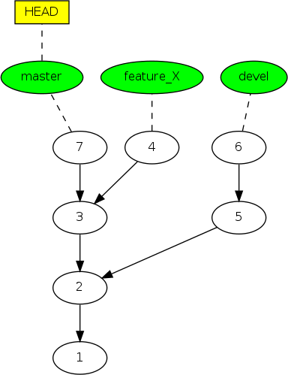
Current branch/checked out branch
There is anotion of a ‘currently
checked out’ branch.
This is denoted by a special ref called HEAD.
HEAD is asymbolic ref, which points to the ‘current branch’.
25 / 52

Slide 26
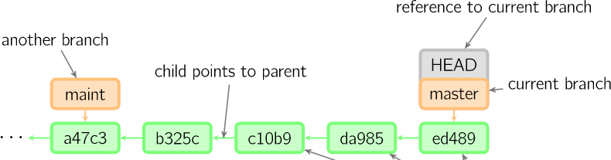

So, what does a typical project look like?
A bunch of commits linked together that live on some branch, contained in a repository
Time going forward

Slide 27

So, what is HEAD?
A reference to the most recent commit
(in most cases – not always true!)
Time going forward

Slide 28
So, what is MASTER?
The main branch in your project
Doesn’t have to be called master, but almost always is!
Time going forward

Slide 29
Key Concepts: Branching oﬀ of the master branch
The start of a branch points to a specific commit
When you want to make any changes to your project you make a new
branch based on a commit

Slide 30
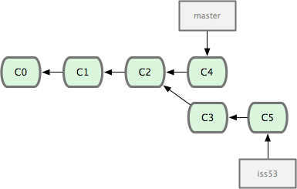
Key Concepts: Branching oﬀ of the master branch
Time going forward

Slide 31
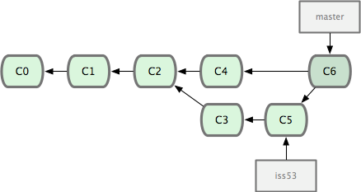

Key Concepts: Merging
Once you’re done with your feature, you merge it back into master
Time going forward

Slide 32
Key Concepts: How do you make a commit anyway?
There are a lot of ‘states’ and ‘places’ a file can be
Local on your computer: the ‘working directory’
When a file is ready to be put in a commit you add it onto the
‘index’ or ‘staging’
Staging is the new preferred term – but you can see both ‘index’ and ‘staging’ being used

Slide 33
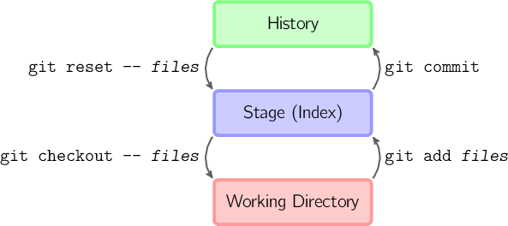
Working locally and committing to a repo
Commiting to the repository (Local Repo) is a 2 step process :
staging (only what’s necessary)
committing (when it’s complete)
1
2
Local Repo
33 / 52

Slide 34
git workflow
How commits are created?
Introduce changes (Working Area)
git add
Add the change to staging area
(Index)
git commit
Make that change “permanent” (local Repo)

Slide 35
The three steps of git
Introduce a change: introduce a change to a file
that is being tracked by git
Introduce changes
git add
Add the actual change to staging area: Add the change you actually want using “git add”
Commit git commit
Add the change to staging area
git commit
Make that change
“permanent”

Slide 36
Key Concepts: How do you make a commit anyway?
The process:
Make some changes to a file
Use the ‘git add’ command to put the file onto the staging environment
Use the ‘git commit’ command to create a new commit’

Slide 37
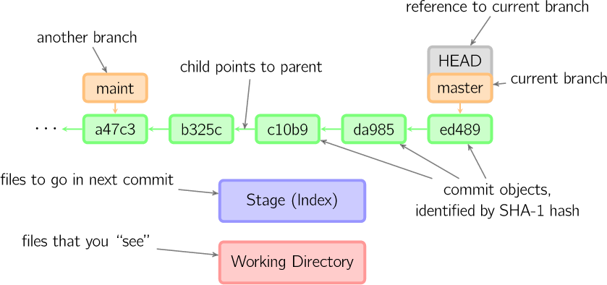

Key Concepts: How do you make a commit anyway?
Time going forward

Slide 38
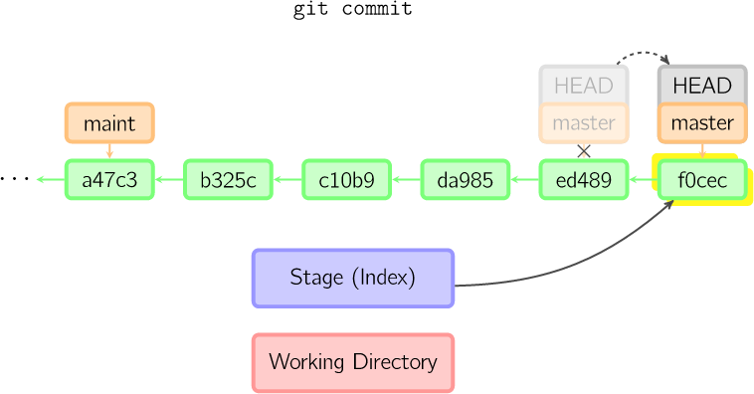
Key Concepts: How do you make a commit anyway?
Time going forward

Slide 39
3
Git commands for beginners

Slide 40
Git commands
For most of the basic interactions with git you’ll mainly use commands
that we’ll cover here
git pull
git push
git init
git clone
git log
git diff
git status
git add
git commit
git merge

Slide 41
git pull
Pulls the changes/commits from Remote Repository to
Local Repository.
Working Area
Terminal command:
git pull
git add
staging area
(Index)
git commit
git pull
Remote Repo
local Repo

Slide 42
git push
Pushes the changes from Local Repository to Remote
Repository.
Working Area
Terminal command:
git push
git add
staging area
(Index)
git commit
git push
Remote Repo
local Repo

Slide 43
git init
Creates a new git repository
Can be used to convert an existing, unversioned project
to a git repository or initialize a new empty repository

Slide 44
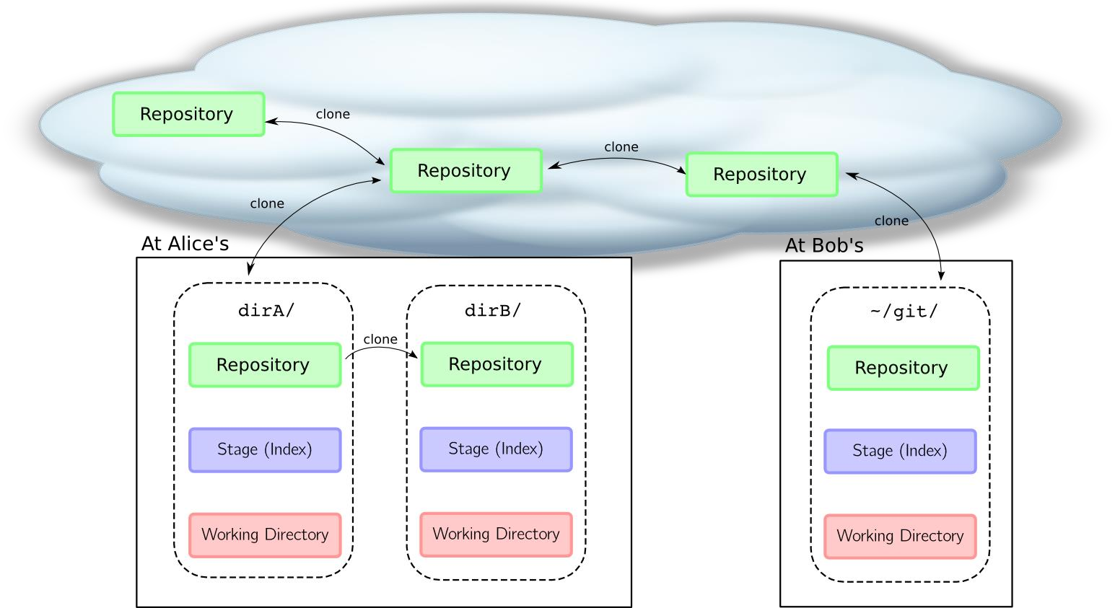
git clone
Copies an existing git repository. You can create a copy of remote repo or local repo

Slide 45
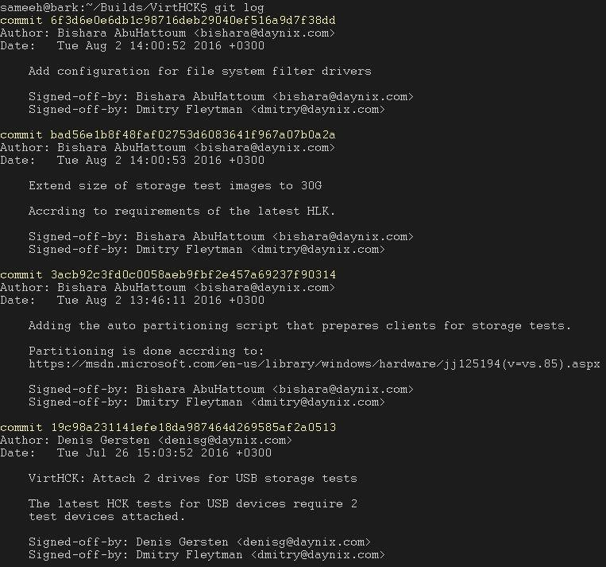
git log
Shows the commit logs of checked out branch

Slide 46
git add
Adds changes into staging area
Working Area
git add
Terminal commands:
git add <file> //adds a
staging area
single file into staging area
git add . //adds all files into staging area
git commit
Local repo

Slide 47
git commit
Creates a commit out of the
changes that had been added
Working Area
Terminal commands:
git add
staging area
git commit –m “commit message”
//adds a commit with a message to the repo
git commit
Local repo

Slide 48
git diff
Displays the change that was introduced
Useful flag
--cached:
Displays the change that was added using “git add”

Slide 49
git status
Displays the file names that has been modified, added and untracked
Terminal Command:
git status //shows files modified, added and untracked
in working directory and staging area

Slide 50
git checkout
Checking out a commit makes the entire working directory match that commit
Terminal Command:
git checkout <branchname> //changes head from
one branch to another branch
git checkout –b <branchname> //create new branch and switch to it

Slide 51
git merge
Merge the changes of 2 branches and show conflicts.
Terminal command:
git merge <branch2> //merges branch2 into your active branch branch1
Branch1
Branch2
Time going forward

Slide 52
4
What is GitHub?

Slide 53
What is GitHub?
www.github.com
Largest web-based git repository hosting service
Aka, hosts ‘remote repositories’
Allows for code collaboration with anyone online
Adds extra functionality on top of git
UI, documentation, bug tracking, feature requests, pull requests,
and more!

Slide 54
What is GitHub?
Founded in 2008
Also has an Enterprise edition for businesses

Slide 55

5
Install git and a create GitHub account

Slide 56
Install git
Linux (Debian)
Command: sudo apt-get install git
Linux (Fedora)
Command: sudo yum install git
Mac
http://git-scm.com/download/mac
Windows
http://git-scm.com/download/win

Slide 57
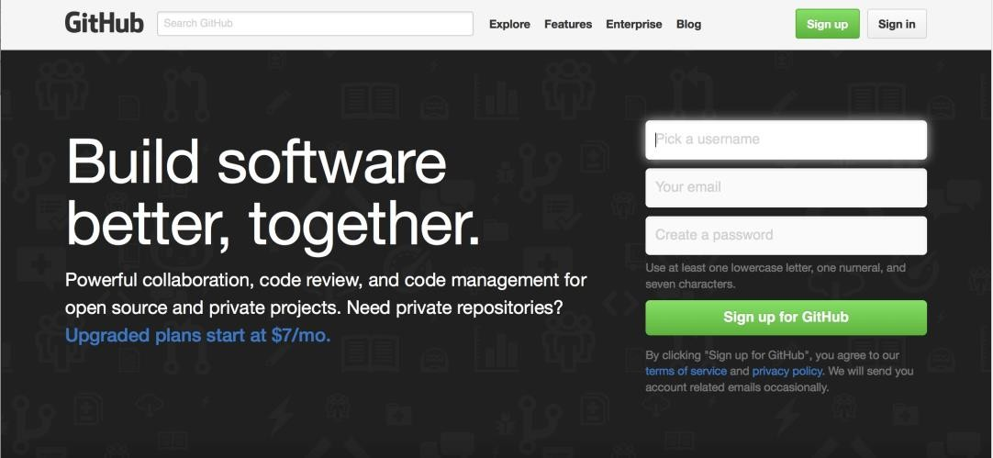
Create Github account
www.github.com
Free for public repositories

Slide 58


Additional Resources

Slide 59
Additional Resources
Official git site and tutorial: https://git-scm.com/
GitHub guides:
https://guides.github.com/
Command cheatsheet:
https://training.github.com/kit/ downloads/github-
git-cheat-sheet.pdf
Interactive git tutorial:
https://try.github.io/levels/1/challenges/1
Visual/interactive cheatsheet:
http://ndpsoftware.com/git-cheatsheet.html

